Slide 1

Hamdard University
Department of Computer Science(FEST)
Final Year Project 1st Evaluation
Services Management System

Slide 2
Group Introduction
Members:
Muhammad Areeb Vohra [BSCS/F14/0112]
Abdul Moiz Hussain [BSCS/f14/0128]
Muhammad Taha Amin [BSCS/F14/0117]
Supervisor:
Sir Adnan Ahmed Siddiqui (Assist. Professor)
Co-supervisor:
Sir Muhammad Fahad

Slide 3
Summary
Problem Statement
Aims & Objectives
Project Scope (Big Picture & Usage Scenario)
Literature Reviews
Project Plan (Gantt Chart & Timeline)
Project Tools
Budgeting
Project Deliverables
References
Q&A

Slide 4
Problem Statement
In housing societies, problems regarding any household issues like electricity, plumbing, gas leakage, carpentry, fumigation, etc. the person himself has to go and bring the repair man, which takes a lot of time and effort.

Slide 5
Aims & Objectives
The main objective of this project is to develop a web & smart-phone based application that can be used to inform about any of the household problem in an easier way.
Due to the common use and access of androids and web pages, these platforms are targeted for this project’s UI.
And definitely a web based Service Control Manager, where all users and workers will supervised.

Slide 6
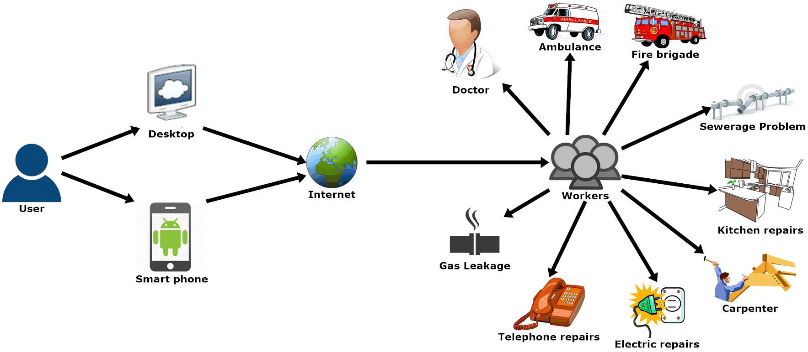
Project Scope (Big Picture)

Slide 7
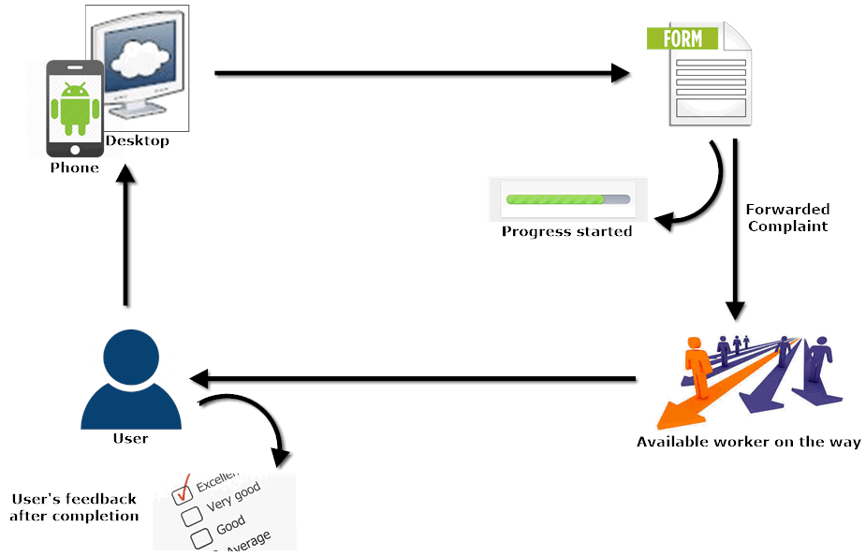
Project Scope (Usage Scenario)

Slide 8
Project Scope
Functional Requirements:
User can request for any service which will be connected to the operator.
Provide accessibility to the android/web application through internet connectivity.
A database that will store the information about the users and workers to be displayed to the operators.
Non-Functional Requirements:
A friendly Graphical User Interface.
An upgradable system, in future if needed.
Availability of android application on Google Play Store, and web application.

Slide 9
Literature Reviews ^{(Continued)}
Study of Implementation of Society Management System ^{[1]}
In this paper, people are notified about every activity of the society through the application.
So, business oriented citizens without much interaction will be able to interact with their society’s daily activities.

Slide 10
Literature Reviews ^{(Continued)}
Ubiquitous Smart Home System Using Android Application ^{[2]}
In this review an android application and an Arduino, as its server, is used to control the appliances of a home.
This methodology can be helpful to control the complaints of the society, by using internet server/domain instead of Arduino, as a connecting medium.

Slide 11
Literature Reviews ^{(Continued)}
Implementation of Society Management System: SOCIETALES^{[3]}
The paper uses online posting of the complaints using android applications for any residential society.
A society has to deal with many complaints involving:
Water supply
Maintenance of electricity etc.
So to manage everything on a single platform would help to maintain a well-defined environment within the society with the help of:
Complaint box
My Complaints
Notice board
Meetings Schedule etc.

Slide 12
Literature Reviews ^{(Continued)}
Ubiquitous Home Control and Monitoring System Using Internet of Things ^{[4]}
This project uses Internet of Things (IoT) to monitor houses in the society and monitor/control appliances of the house too.
It uses wireless network or 3G/4G to connect 8051 microcontroller as a hosting controller.

Slide 13
Literature Reviews ^{(Continued)}
Implementation of Facility Maintenance Management System using Smart Phone ^{[5]}
This paper proposes an integrated android based mobile application and a web based system that facilitates maintenance management in apartment buildings that saves unnecessary man power that can be used in other aspects.
The methodology of creating an integrated mobile application and web based system is useful to consult the idea of our project.

Slide 14
Literature Reviews (Conclusion)
Reviewed Services:
My Complaints
Push Notifications
Notice Board
Meeting Schedule
Complaint Status
History
Feedback (Reviews & Ratings)

Slide 15
UML Diagram (Web)

Slide 16
Progress So Far
Fully functional website including: Front end: User panel Backend: Admin panel
Web-Form for registration of new workers in database.

Slide 17
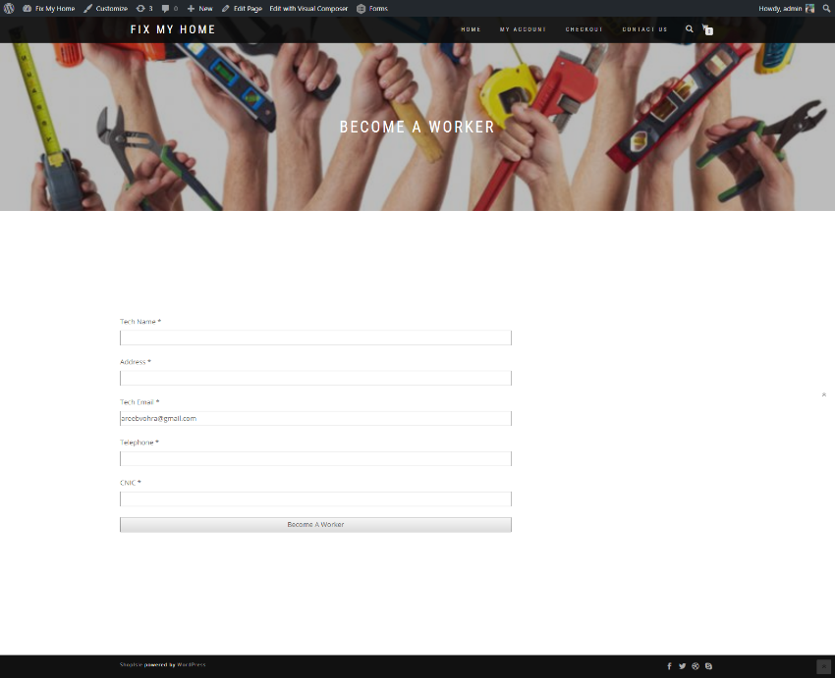
Evidence of Project^{(continued)}

Slide 18
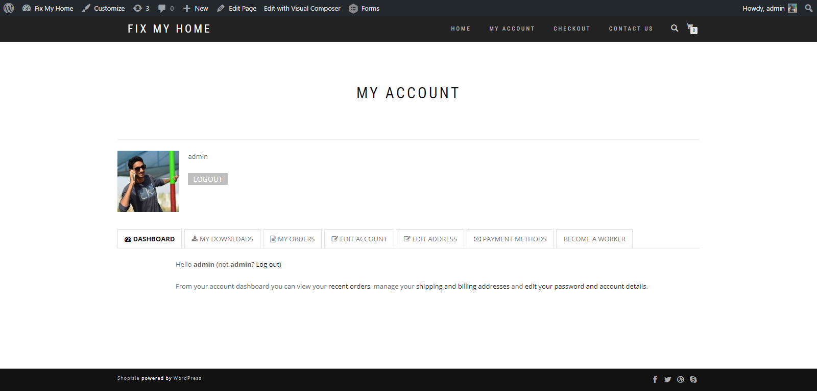
Evidence of Project^{(continued)}

Slide 19
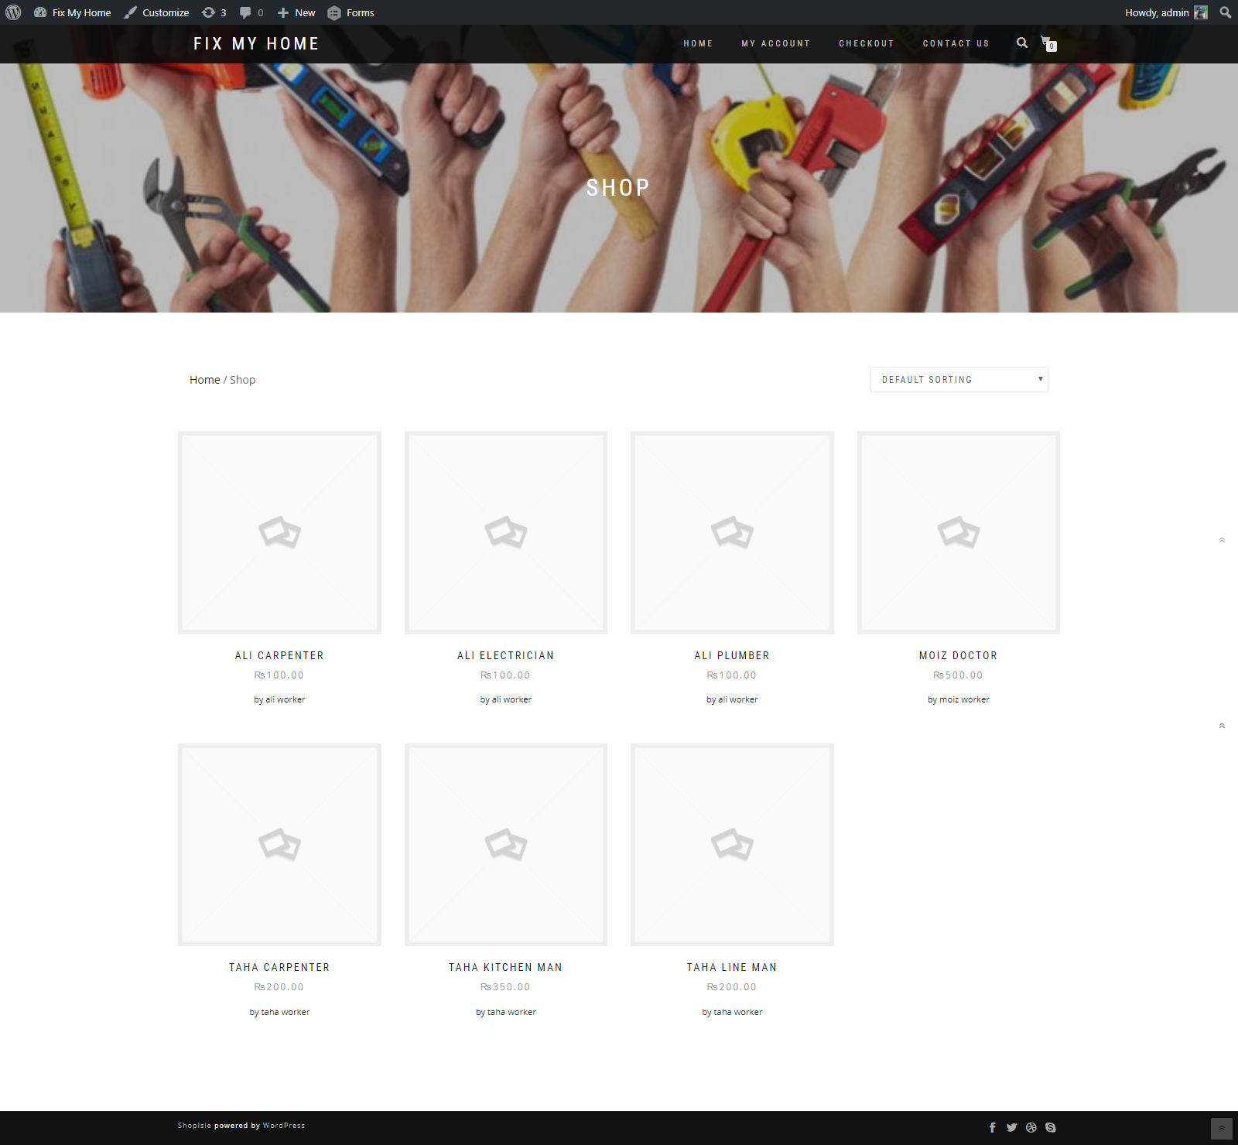
Evidence of Project

Slide 20
Problems Encountered
Had less knowledge concerning the platform and concepts were not aligned.
In automating complaint submission and assigning worker.
Getting used to in customizing WordPress plugins.
In creating Spinner (dropdown menu) for multiple entries.

Slide 21
Project Plan (Gantt Chart)
Task Name | Duration | Start | Finish
FYP 1st Evaluation Gantt Chart | 150 days | Tue 8/1/17 | Wed 1/31/18
Requirement Analysis | 40 days | Tue 8/1/17 | Tue 10/10/17
Elicitation of Requirement |  | Tue 8/1/17 | Tue 10/10/17
Analysis of Requirement |  | Tue 8/1/17 | Tue 10/10/17
Requirement Validation |  | Mon 8/14/17 | Tue 10/10/17
Designing | 30 days | Mon 9/11/17 | Fri 12/1/17
Web Design |  | Wed 9/27/17 | Tue 11/7/17
Web Application Design |  | Wed 9/27/17 | Tue 11/7/17
Implementation | 40 days | Mon 11/20/17 | Fri 1/12/18
Web Development |  | Mon 11/20/17 | Fri 12/15/17
Web Application Development |  | Mon 11/20/17 | Fri 12/15/17
Testing | 50 days | Mon 9/11/17 | Wed 1/31/18
Black Box Testing |  | Mon 9/11/17 | Wed 1/31/18
White Box Testing |  | Mon 9/11/17 | Wed 1/31/18

Slide 22
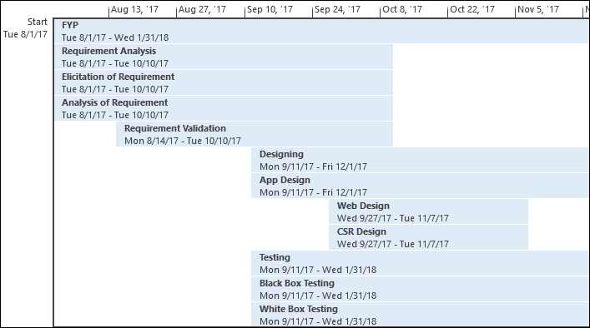
Project Plan (Timeline)^{(continued)}

Slide 23
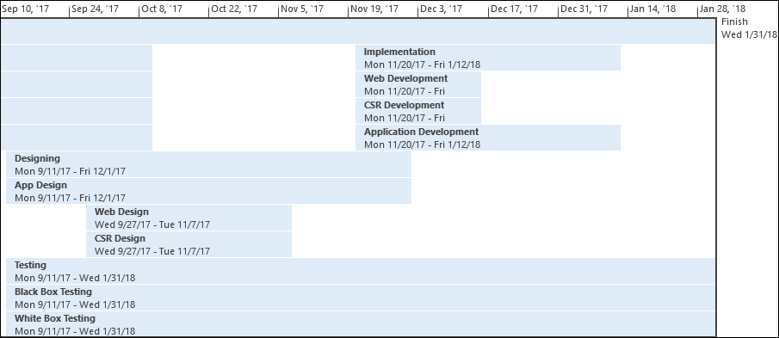
Project Plan (Timeline)

Slide 24
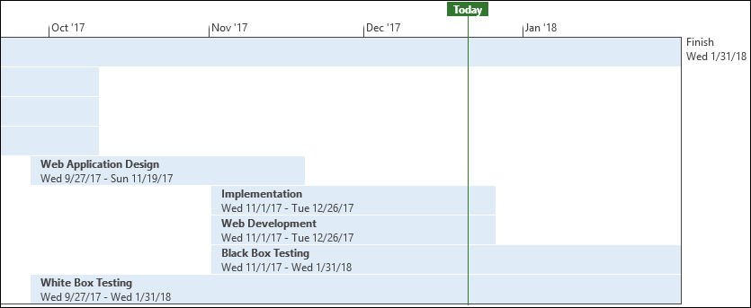
Current Status (in Timeline)

Slide 25
Software Tools
Android Application Development:
Android Studio
Web Application Development:
WordPress 4.6
Sublime Text 2 (2.0.2)
VS Code
Database
MySQL 5.5
Documentation:
MS-Office 2013
EndNote 7
Smart Draw 2010
Microsoft Visio 2013
MS-Project 2013
REST API Testing:
Insomnia
Postman

Slide 26
Plugins Used
Admin Menu Editor Pro
Gravity Forms
Js Composer
WooCommerce
Gravity Forms Product Add-ons – WooCommerce
YITH WooCommerce Multi-step Checkout
YITH WooCommerce Customize My Account Page
YITH WooCommerce Multi Vendor

Slide 27
Hardware Tools
Desktop/Laptop – for Web & Mobile Application development.
Internet (3G/4G) Device – for mobility of internet.

Slide 28
Budget of the Project
Desktop/Laptop ≈ 25,000 PKR
Internet (3G/4G) device ≈ 4000 PKR
Total ≈ 53,000 PKR.

Slide 29
Project Deliverables
First Evaluation:
Design Documents (ERD, Layouts)
Running Website (Admin & User Panel)
Second Evaluation:
Fully functional:
Website
Android Application
Project Report (Including coding documents’ soft copies)

Slide 30
References
Gavhane, Shivganga, Rutuja Vatharkar, Swati Sonar, and Pratiksha Patil. "Study of Implementation of Society Management System." International Journal of Computer Applications 132, no. 1 (2015): 34-36. [PDF] [⇦]
Kumar, Shiu. "Ubiquitous Smart Home System Using Android Application." arXiv preprint arXiv:1402.2114 (2014). [PDF] [⇦]
Vatharkar, Rutuja, Pratiksha Patil, Swati Sonar, and Shivganga Gavhane. "Implementation of Society Management System: Societales.“ [PDF] [⇦]
Kumbhar, Miss Dardi Madhura Rajendra3 Miss, and Amruta Dilip. "Ubiquitous Home Control and Monitoring System Using Internet of Things." (2016). [PDF] [⇦]
Joo, Young-Do. "Implementation of Facility Maintenance Management System Using Smart Phones." The Journal of The Institute of Internet, Broadcasting and Communication 13, no. 1 (2013): 191-97. [PDF] [⇦]

Slide 31
Q&A

Slide 32
Thank you

